Slide 1
Data Analysis
Jonathan Yuquimpo

Slide 2
R Markdown
This is a paragraph in an R Markdown document.
Below is a code chunk:
fit = lm(dist ~ speed, data = cars) b = coef(fit) plot(cars) abline(fit)

Slide 3
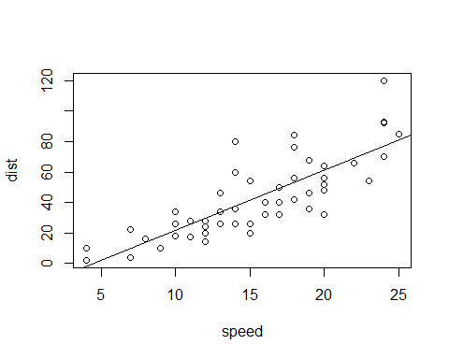

Slide 4
The slope of the regression is 3.9324088.

